Slide 1
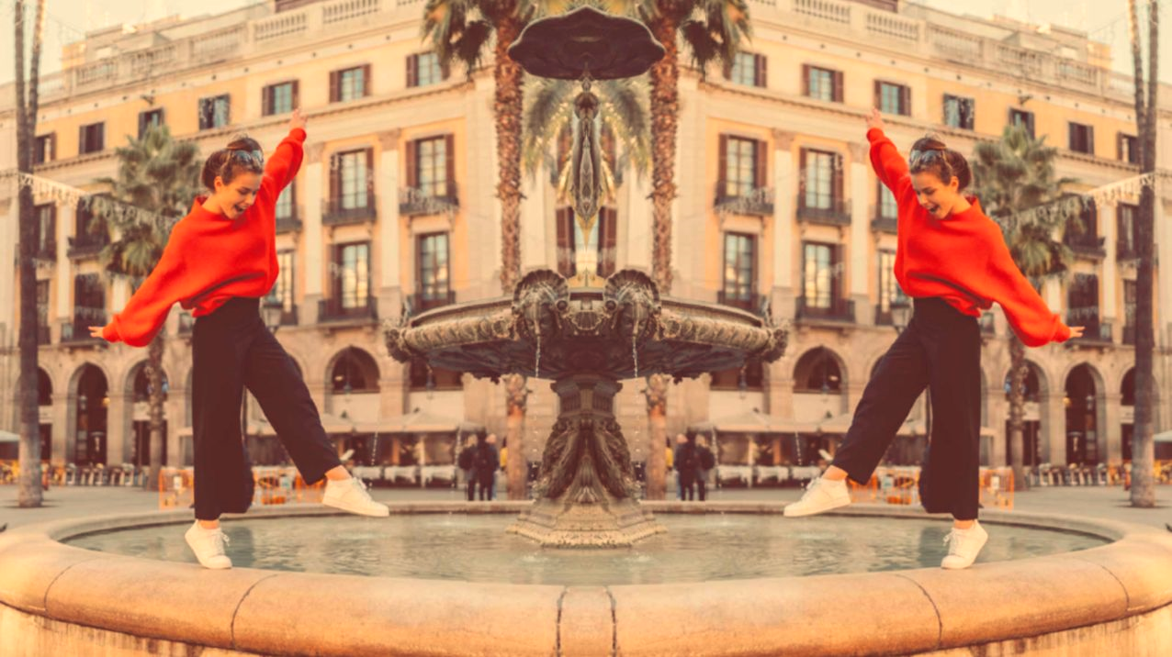
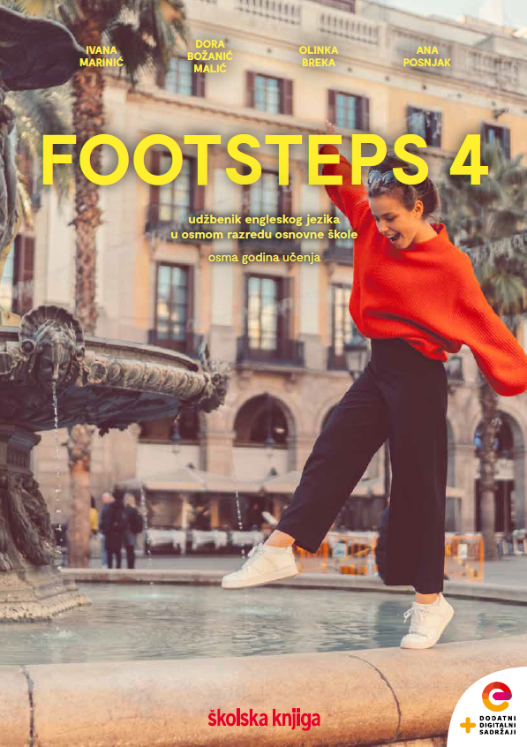

UNIT 6; Lend me your ear
Self-check 6

Slide 2
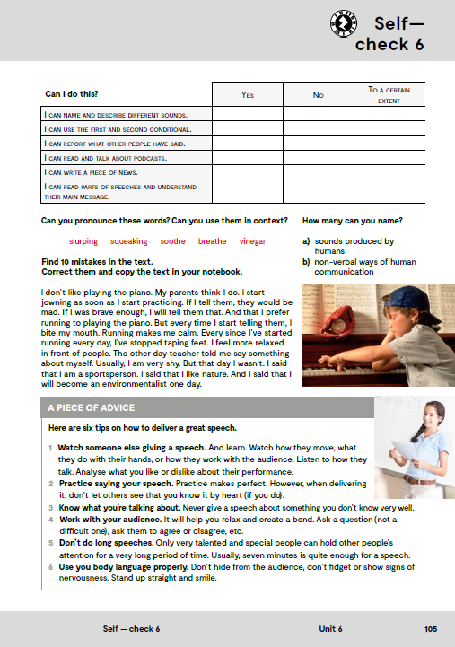
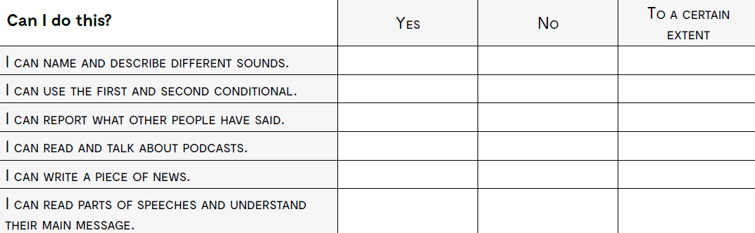
imenovati i opisati različite zvukove
koristiti prvi i drugi kondicional
prenijeti govor drugih
čitati i razgovarati o podcastima
napisati vijest
pročitati dijelove nečijeg govora i razumjeti poruku

Slide 3
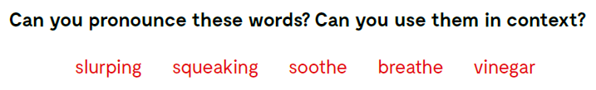
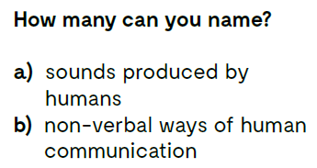

Slide 4
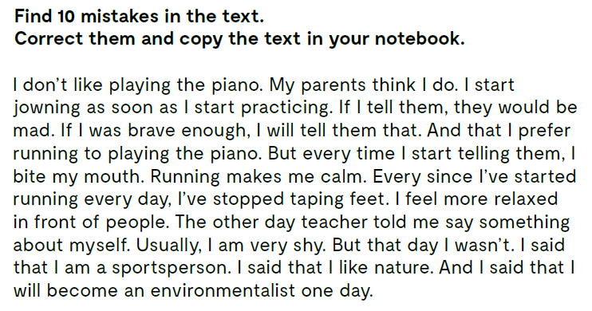
I don’t like playing the piano. My parents think I do. I start jawning as soon as I start practicing.
If I tell them, they will be mad.
If I was brave enough, I would tell them that. And that I prefer running to playing the piano.
But every time I start telling them, I bite my lip. Running makes me calm.
Ever since I’ve started running every day, I’ve stopped tapping feet. I feel more relaxed in front of people.
The other day teacher told me to say something about myself. Usually, I am very shy. But that day I wasn’t.
I said that I was a sportsperson.
I said that I liked nature.
And I said that I would become an environmentalist one day.

Slide 5
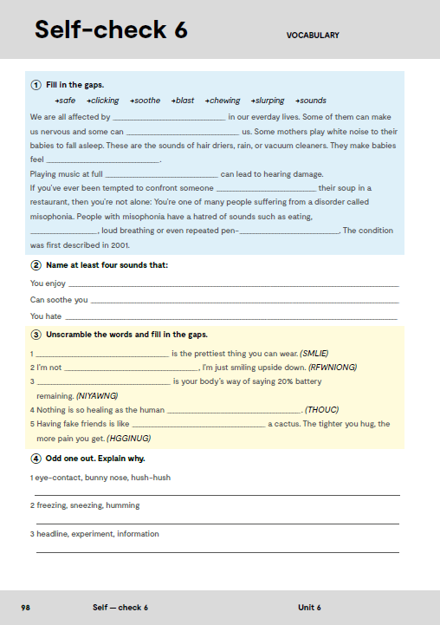
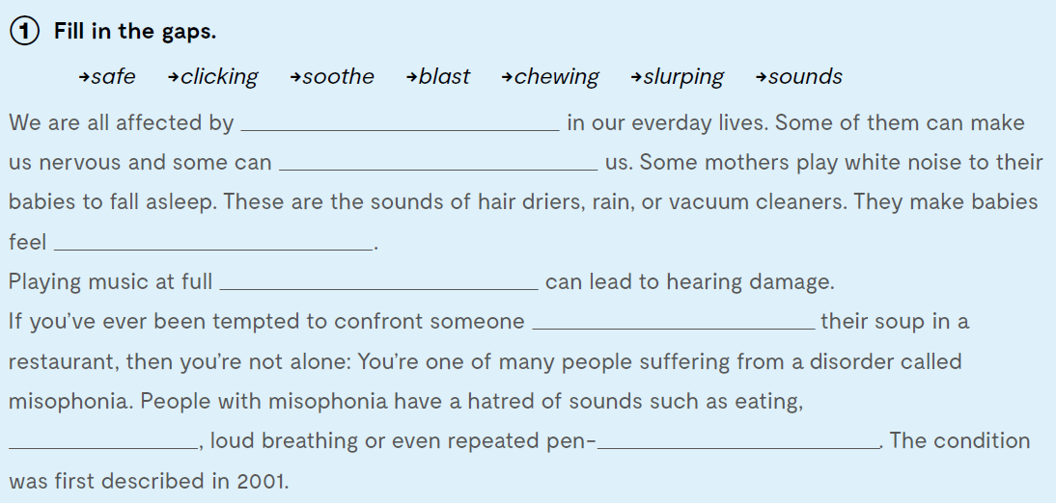
Workbook, page 82.
sounds
soothe
safe
blast
slurping
chewing
clicking

Slide 6
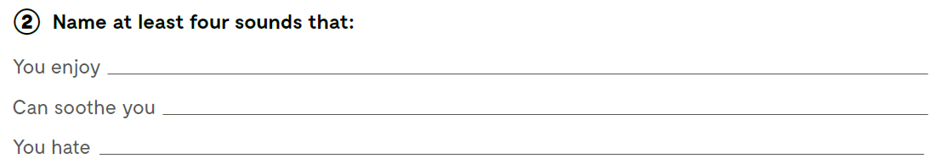

Slide 7
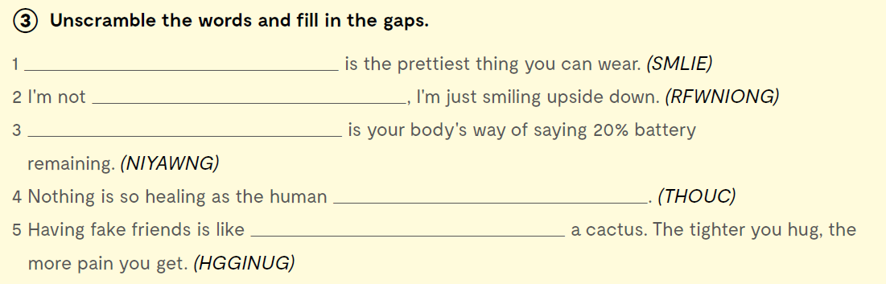
Smile
frowning
Yawning
touch
hugging

Slide 8
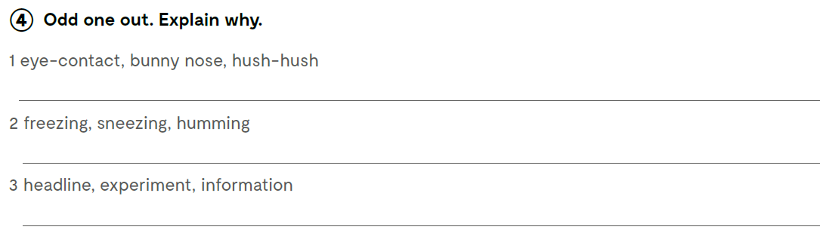

Odd one out. Izbaci uljeza.
Check what you have learnt: Provjeri koliko si naučio:
https://wordwall.net/play/13347/792/240

Slide 9
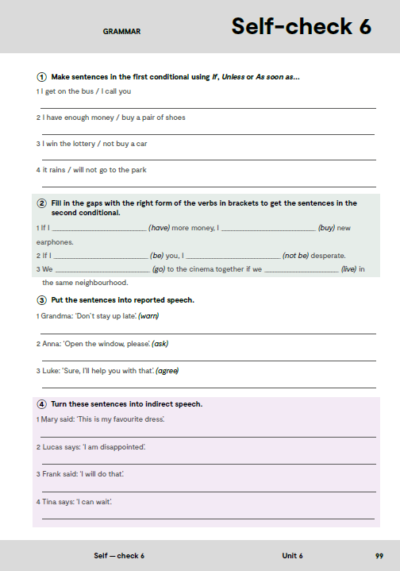
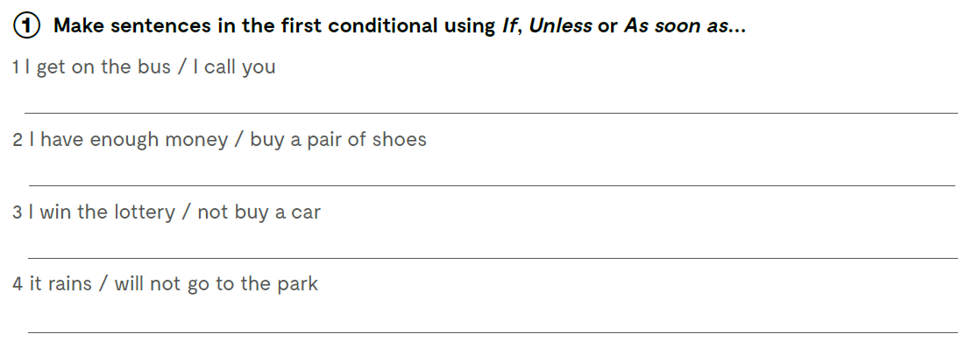
As soon as I get on the bus, I will call you.
If I have enought money I will buy a pair of shoes.
Unless I win the lottery, I will not buy a car.
If it rains, I will not go to the park.

Slide 10
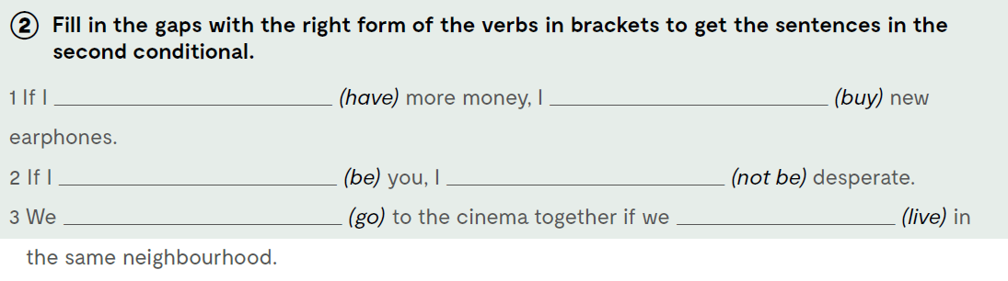
had
would buy
were
wouldn’t be
would go
lived

Slide 11
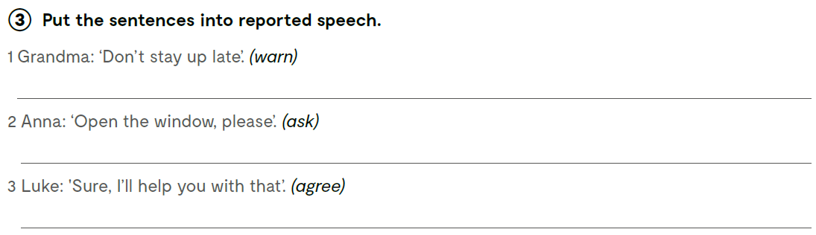
Put the sentences into reported speech. Prenesi rečenice koje su osobe izgovorile.
Grandma warned me not to stay up late.
Anna asked me to open the window.
Luke agreed to help me with that.

Slide 12
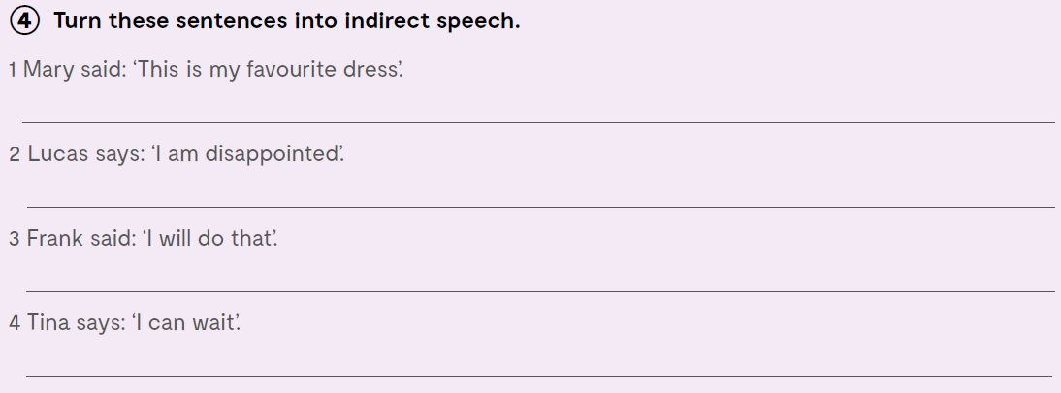
Mary said that was her favourite dress.
Lucas says he is disappointed.
Frank said he would do that.
Tina says she can’t wait.

Slide 13
